Slide 1
Don’t Be The Next Tea:
Defense in Depth for Founders
wolfy

Slide 2

CV

Slide 3
CV, cont
UTSA 2020, BS in CS
Missile Defense Agency, 2020-2023
Cofounder & CTO, Fabra & TapIQ, 2024-2026
Senior SWE, TrueBiz, present

Slide 4
Who This Talk Is For
Non-technical founders
Vibe coders
People with no tech knowledge

Slide 5
What Was Tea
Women only “whisper network” app
Warn each other about catfishing, creeps, etc
Provide ID to prove you’re a woman during signup
All IDs were saved to a public storage bucket

Slide 6
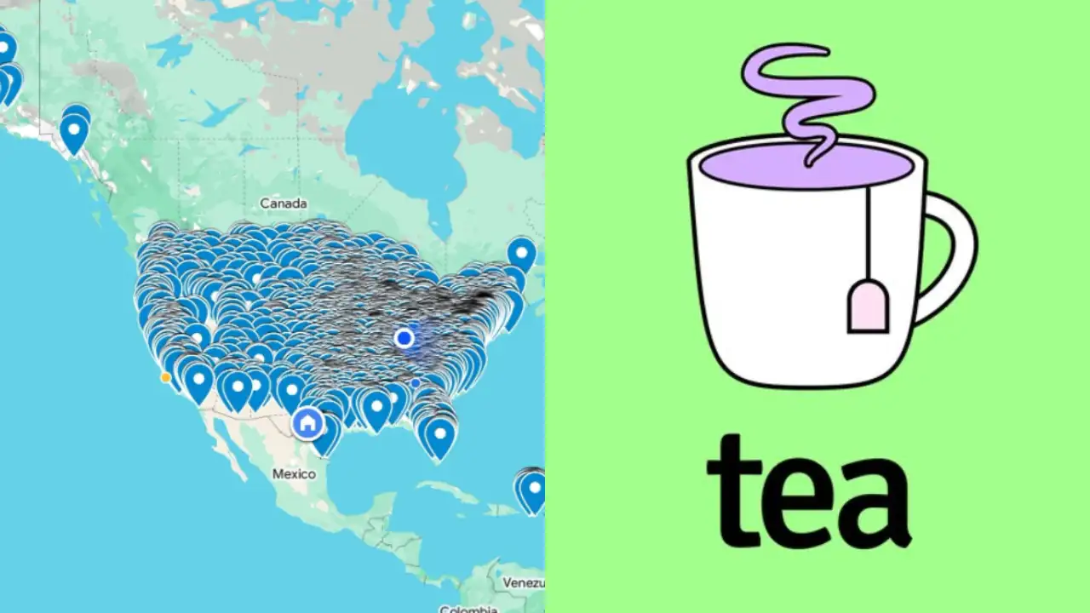
What Was Tea, cont.

Slide 7
Private By DEFAULT
If you take uploads, have 2 SEPARATE buckets
Name them “public” and “private”
Store bucket files in format
users/<user uuid>/<upload uuid>
orgs/<org uuid>/<upload uuid>
Dedicated code path the user must trigger to make an asset you store public

Slide 8
Do Not Trust The User
Your user is stupid
Your user is malicious
Validate all inputs to the app

Slide 9
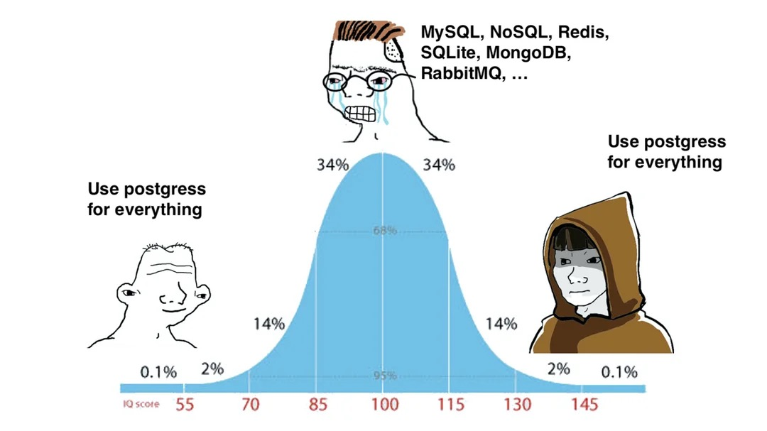
Databases

Slide 10
Databases, cont.
Thou shalt have AT LEAST 2 users
1 – Only able to modify DB schema
2 – Read/write, can’t modify schema
Dedicated read-only user once you need replicas, data-exports, or separate read-only services
NO USING THE ADMIN USER

Slide 11
Databases, cont.
“Row Level Security” isn’t
Use an ORM, do not write raw SQL
Use transactions properly, ideally have a helper that returns a transaction for the query to use
Better to remove an unnecessary transaction than not be using one when you need it

Slide 12
Use a Secret Manager
Names vary but your cloud provider will have one
Use it

Slide 13
Passwords
Don’t
Prefer Magic Links and/or SSO
If you must: minimum 14 chars, no complexity requirements
Use bcrypt2 hashing or a NIST-approved PQC hash algo

Slide 14
Test In Staging
Worth the extra cost
Safe to let clankie blow this up
Make sure the staging DB has a quality representation of what user data looks like, or migrations tested here can pass when they should fail

Slide 15
SAST/DAST/fuzzers
Dependabot
SonarQube for IDE
Most languages have linters and quality checkers (ESLint, mypy, ruff)
Too many of these products to list, many free options
OWASP ZAP

Slide 16
Supply Chain
Pin dependencies to exact version numbers
GH Actions workflows should be pinned to commit SHAs
Enable dependabot to keep these up to date
Stop using javascript

Slide 17
Use .dockerignore
USE IT

Slide 18

Keep Learning

Slide 19
Links
https://github.com/shitwolfymakes/presentations
https://linkedin.com/in/shitwolfymakes

